Slide 1
Esophageal Function Tests
Dr. Ravi (PGY1 - General Medicine)

Slide 2
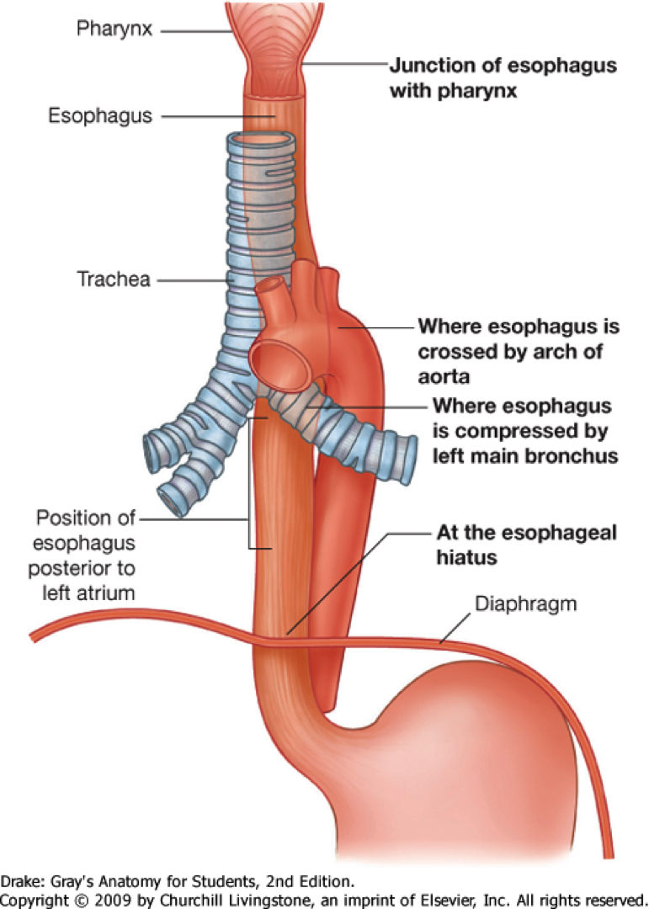
Functions Of The Esophagus
Swallowing
The upper esophageal sphincter first relaxes, allowing a bolus of food to enter.
Rhythmic contraction of the esophageal muscle called peristalsis pushes the food down the esophagus.
These rhythmic contractions occur both as a reflex response to food that is in the mouth, and also as a response to the sensation of food within the esophagus itself. Along with the peristalsis, the lower esophageal sphincter relaxes.

Slide 3
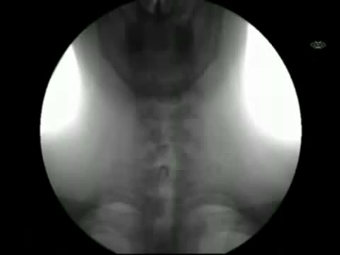
Normal Peristalsis Of The Esophagus

Slide 4
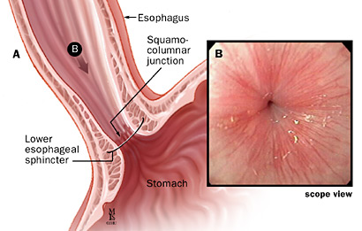
Functions Of The Esophagus
Reducing gastric reflux
Constriction of the upper and lower esophageal sphincters help to prevent reflux of gastric contents and juices into the esophagus, protecting the esophageal mucosa.
the acute angle of His and the lower crura of the diaphragm helps this sphincteric action

Slide 5
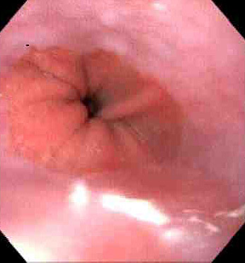
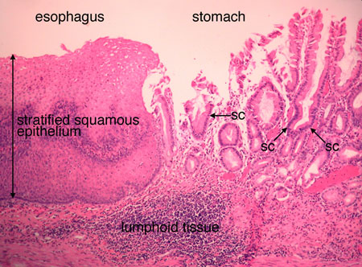
Gastroesophageal Junction
Notes:
Pink color is that of the esophageal mucosa (stratified squamous epithelium)
Dark red is that of the gastric mucosa. (simple columnar epithelium)
This junction is called the z line.
The location of the lower esophageal sphincter is 3 cm distal to the z line.

Slide 6
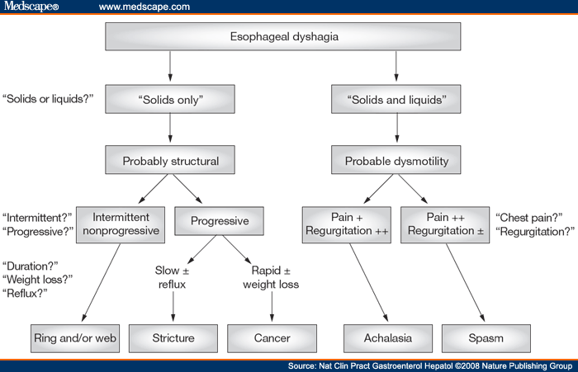
Symptoms of disorders of esophageal function
Dysphagia

Slide 7
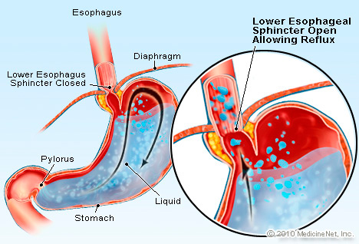
Symptoms of disorders of esophageal function
Heartburn
GERD most common cause of heartburn but first cardiac causes must be ruled out
GERD can cause episodes of non-cardiac chest pain that resemble ischemic cardiac pain

Slide 8
Esophageal function tests
Used to diagnose the cause of dysphagia and/or heartburn
EFT’s include
Esophageal Manometry
24 Hour Esophageal pH monitoring
Bernstein test and Acid Clearing Test
X Ray Tests
- Barium Swallow Fluoroscopy
- Barium Swallow X-Rays

Slide 9
Esophageal Manometry
Preparation
Procedure
Risks
Normal results
Abnormal results & their interpretation

Slide 10
Esophageal Manometry
Preparation
The patient is asked not to eat or drink anything after midnight before the esophageal manometry test
Patient asked to avoid smoking
Many medications affect the esophagus; doses may need to be adjusted or even discontinued prior to testing
Drug & allergic history must be taken
Explain the procedure
Notes:
PPI, Antacids; H2 Blockers – Cimetidine, Ranitidine etc; Corticosteroids
Anticholinergics, Cholinergics, Adrenergic Blockers

Slide 11
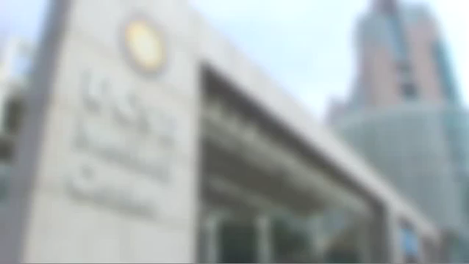
Esophageal Manometry
Procedure

Slide 12
Esophageal Manometry
Risks
Most patients are able to swallow and adjust to the manometry catheter
However, some patients may gag and aspirate the gastric juices

Slide 13
Esophageal Manometry
Normal Result
Basal LOS pressure | 10–45 mm Hg
LOS relaxation with swallow | Complete
Wave progression | Peristalsis progressing from UOS through LOS at a rate of 2–8 cm/s
Distal wave amplitude | 30–180 mm Hg (average of 10 swallows at two recording sites positioned 3 and 8 cm above the LOS)
Notes:
http://gut.bmj.com/content/49/1/145/T2.expansion.html

Slide 14
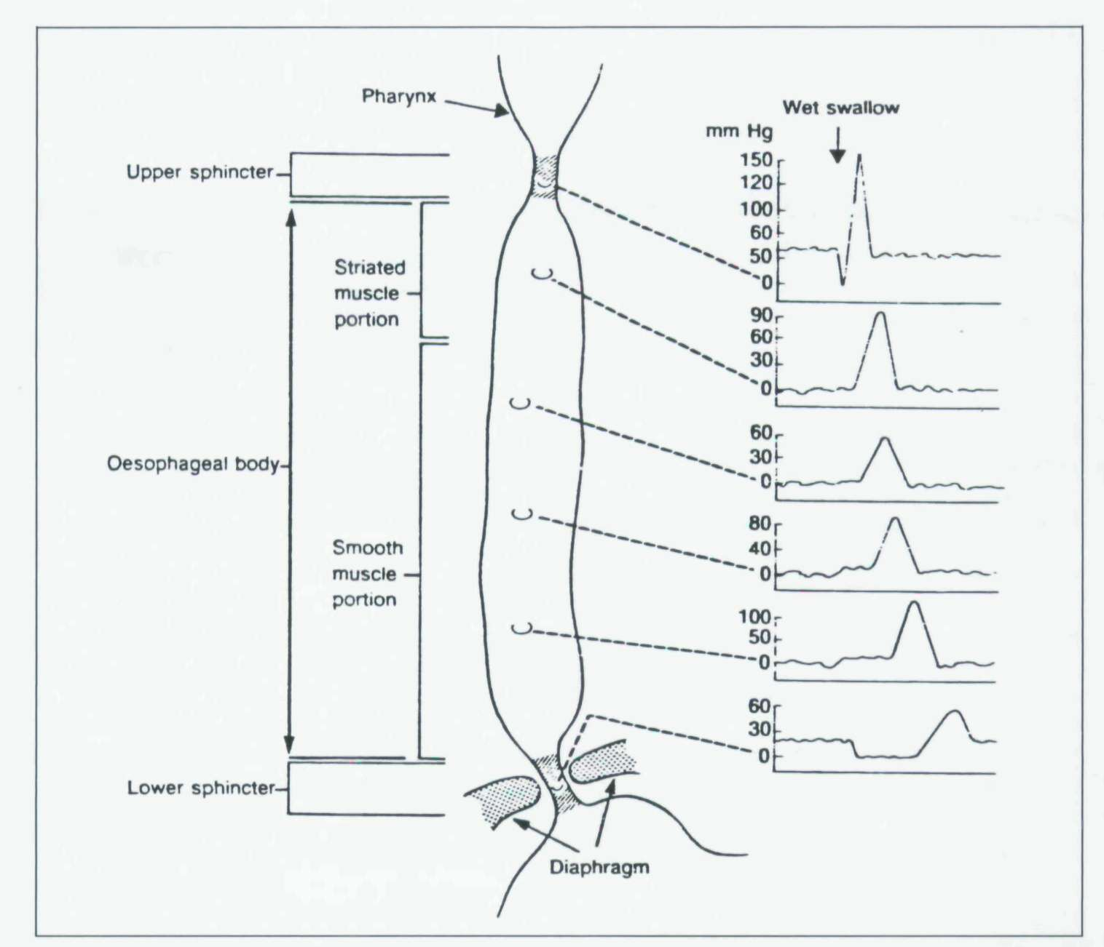
Normal Tracing
Notes:
X axis denotes time
Y axis denotes pressure
The peristaltic wave represented by the upward deflection is progressing downward with time

Slide 15
Esophageal Manometry
Classification of motility abnormalities
Inadequate LOS relaxation
Classic achalasia
Uncoordinated contraction
Diffuse esophageal spasm
Hypercontraction
Nutcracker esophagus
Hypocontraction
Ineffective esophageal motility

Slide 16
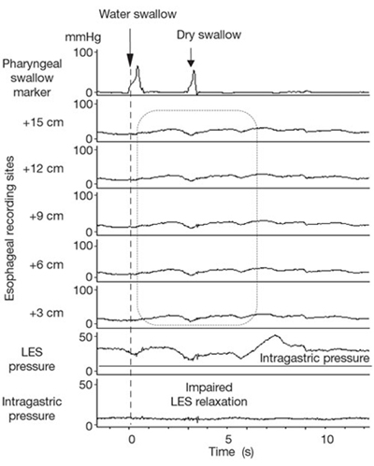
Esophageal Manometry
Classic achalasia tracing
Notes:
The tracing illustrates the findings in classic achalasia with esophageal body aperistalsis with low-amplitude simultaneous esophageal body contractions and failed relaxation of the lower esophageal sphincter.

Slide 17
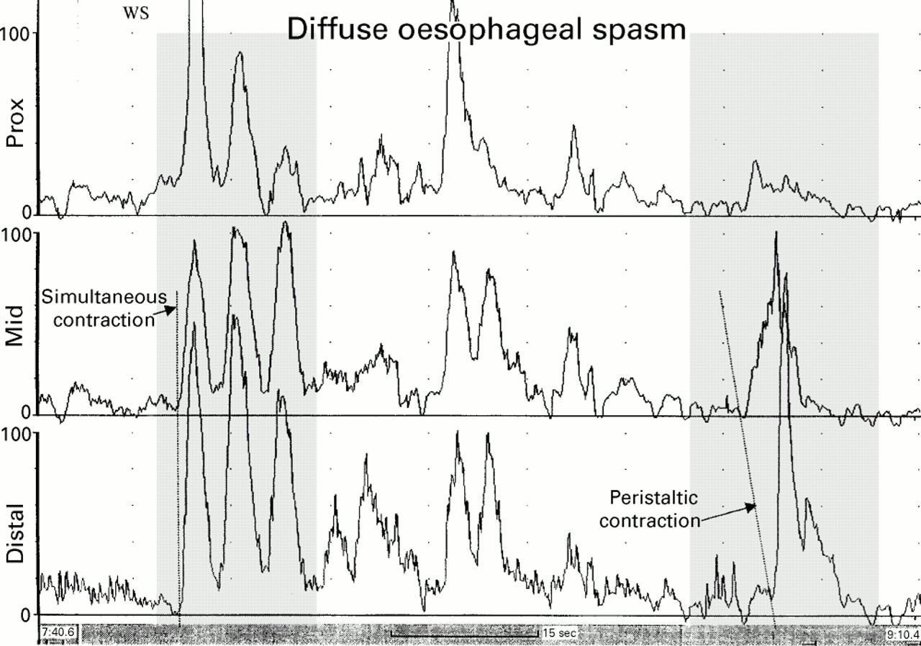
Esophageal Manometry
Diffuse esophageal spasm tracing
Notes:
Oesophageal manometry tracing from a patient with diffuse oesophageal spasm. The recording sites are positioned 3, 8, and 13 cm above the lower oesophageal sphincter. Note that the first wet swallow (WS) is followed by oesophageal contractions that are simultaneous and repetitive. However, some peristaltic activity is preserved, as evidenced by the peristaltic contraction of the oesophageal body shown in the sequence on the right.

Slide 18
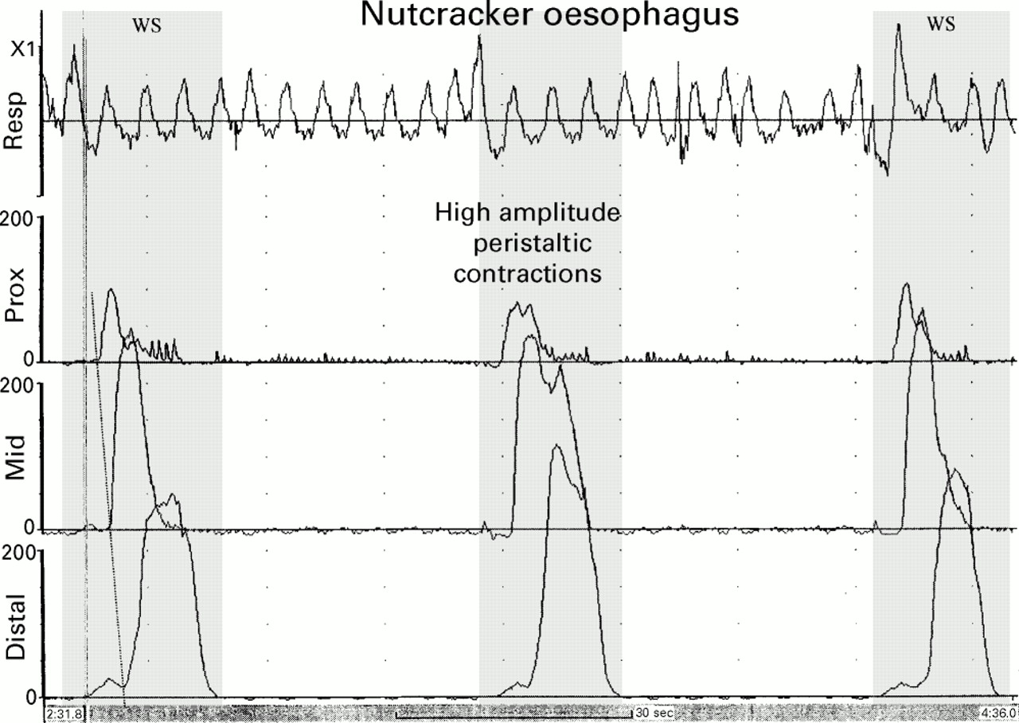
Esophageal Manometry
Nut cracker esophagus tracing
Notes:
Oesophageal manometry tracing from a patient with nutcracker oesophagus. The recording sites are positioned 3, 8, and 13 cm above the lower oesophageal sphincter. Note the high amplitude peristaltic contractions initiated by wet swallows (WS).

Slide 19
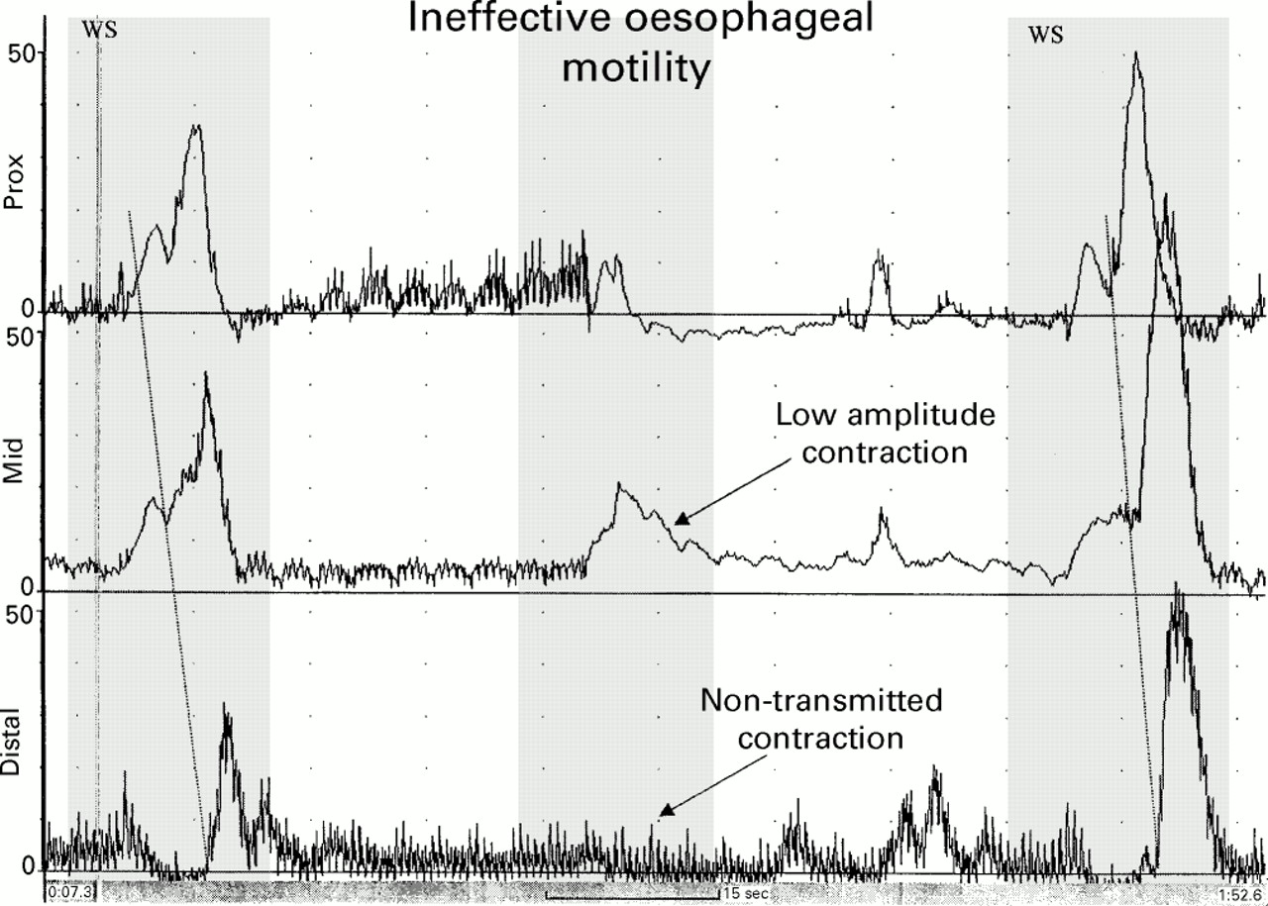
Esophageal Manometry
Ineffective esophageal motility tracing
Notes:
Oesophageal manometry tracing from a patient with ineffective oesophageal motility. The recording sites are positioned 3, 8, and 13 cm above the lower oesophageal sphincter. Note that the first and third wet swallows (WS) result in normal peristaltic sequences. However, the second wet swallow stimulates only low amplitude contractions in the proximal two leads, and no contraction in the distal lead (non-transmitted contraction or “failed peristalsis”).

Slide 20
24 Hour Esophageal pH monitoring
Preparation
Procedure
Risks
Normal results
Abnormal results & their interpretation

Slide 21
24 Hour Esophageal pH monitoring
Preparation
The patient is asked not to eat or drink anything after midnight before the 24 Hour esophageal pH monitoring test
Patient asked to avoid smoking
Many medications affect the esophagus; doses may need to be adjusted or even discontinued prior to testing
Drug & allergic history must be taken
Explain the procedure
Notes:
PPI, Antacids; H2 Blockers – Cimetidine, Ranitidine etc; Corticosteroids
Anticholinergics, Cholinergics, Adrenergic Blockers

Slide 22
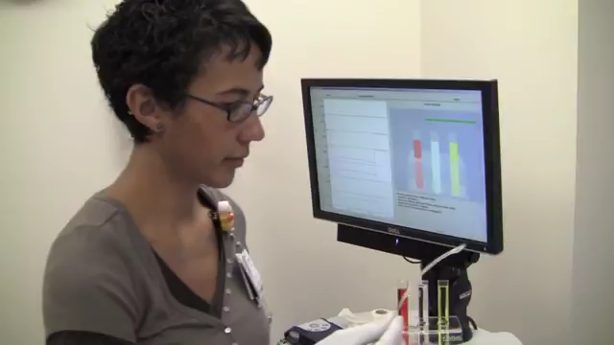

Slide 23
24 Hour Esophageal pH monitoring
Risks
Most patients are able to swallow and adjust to the pH monitoring catheter
However, some patients may gag and aspirate the gastric juices

Slide 24
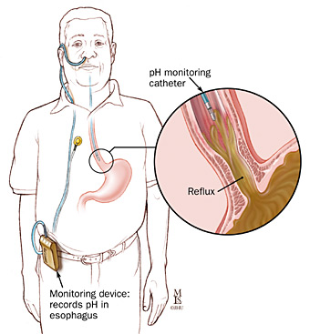
24 Hour Esophageal pH monitoring
Normal Results
Gold standard for diagnosing GERD
The probe measures and records continuously the esophageal pH 5 cm above the upper border of the LES during a 24-hour period

Slide 25
24 Hour Esophageal pH monitoring
Normal Results - Parameters
1. The cumulative time the esophageal pH is below 4 expressed as a percentage of the total, upright and supine time;
2. The frequency of the reflux episodes expressed as the number of episodes per 24 hours; and
3. The duration of the episodes expressed as the number of episodes greater than 5 minutes per 24 hours and the time in minutes of the longest episode recorded

Slide 26
24 Hour Esophageal pH monitoring
Normal Results - Parameters
Why select pH of 4 as the cut off value?
At pH 4 normal subjects first begin to experience the symptom of heartburn
The digestive enzyme pepsin, a key contributor to esophagitis, is activated at a pH of less than 4

Slide 27
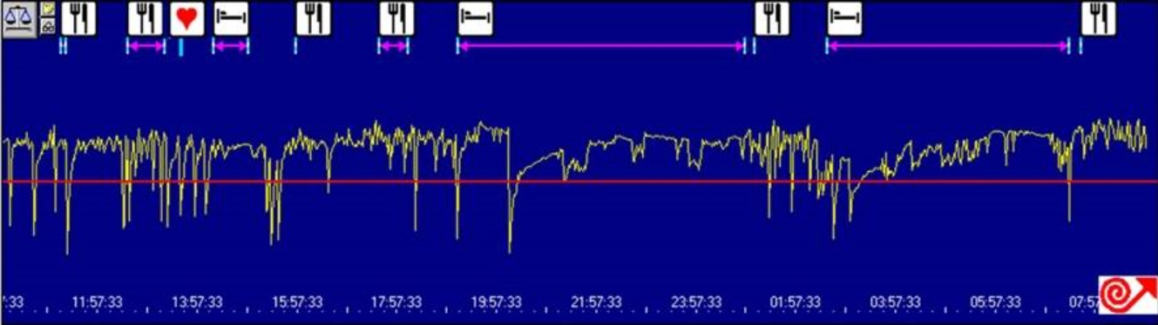
24 Hour Esophageal pH tracing
Patient with GERD
Notes:
X axis indicates time and Y axis indicates the pH. Red line is the cutoff pH value of 4. Each time, the yellow line dips below the red line, it indicates an episode of reflux

Slide 28
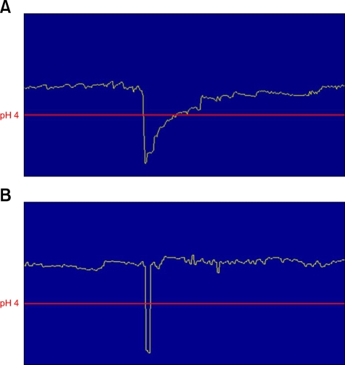
24 Hour Esophageal pH monitoring – True Reflex vs Faulty Electrode

Slide 29
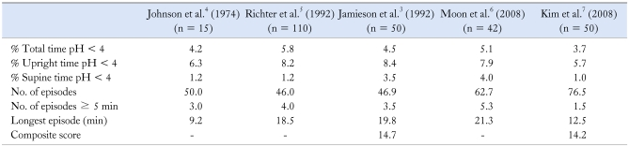
24 Hour Esophageal pH monitoring
Normal Results - Parameters

Slide 30
24 Hour Esophageal pH monitoring
Symptom correlation
An advantage of ambulatory 24 hr esophageal pH monitoring is the ability to correlate symptoms with acid exposure events.
Symptom index (SI) - This involves dividing the number of symptoms associated with pH < 4 by the total number of symptoms yielding a percentage of symptom episodes that correlate with GERD.
Symptom sensitivity index (SSI) - This involves dividing the total number of reflux episodes associated with symptoms by the total number of reflux episodes.

Slide 31
Bernstein test
Also known as the acid perfusion test
A nasogastric (NG) tube is passed into the esophagus and mild hydrochloric acid will be sent down the tube, followed by salt water (saline) solution.
If the patient feels pain from the acid, the test is positive for reflux esophagitis.
If there is no discomfort, another explanation must be sought for the patient's symptoms.

Slide 32
Acid Clearing Test
HCl is also directed into the esophagus.
This test, however, measures the patient's ability to quickly swallow the acid. If the patient has to swallow more than 10 times to move the acid down the esophagus, he or she has a problem with esophageal motility.

Slide 33
Barium Swallow Fluoroscopy
Fluoroscopy is similar to an X-Ray movie
Step 1
Patient asked to swallow a barium preparation in order to visualize the size, shape, position, patency and filling of the esophagus along with the peristaltic movement of the barium through the esophagus in the upright position
Step 2
To test for reflux of the barium from the stomach in the Trendelenburg position
Notes:
In the Trendelenburg position, the body is laid flat on the back (supine position) with the feet higher than the head by 15-30 degrees This is a standard position used in abdominal and gynecological surgery. It allows better access to the pelvic organs as gravity pulls the intestines away from the pelvis. It was named after the German surgeon Friedrich Trendelenburg.

Slide 34
Barium Swallow Fluoroscopy
Preparation
The patient is asked not to eat or drink anything after midnight before the barium swallow fluoroscopy
Patient asked to avoid smoking
Many medications affect the esophagus; doses may need to be adjusted or even discontinued prior to testing
Drug & allergic history must be taken
Explain the procedure

Slide 35
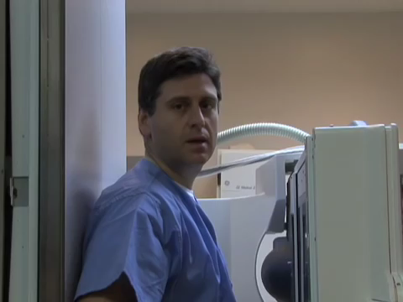

Slide 36


Slide 37
Barium Swallow Fluoroscopy
Risks
Allergic reaction or anaphylaxis may occur in people who are allergic to the barium drink.
Constipation may develop.
Aspiration of the barium into the lungs

Slide 38
Esophageal Function Test
Barium Swallow X Ray (Single & Double Contrast)
Includes both Single Contrast (Barium Only) & Double Contrast
In addition to drinking barium, some patients are also given baking-soda crystals (similar to Alka-Seltzer) to further improve the images. This procedure is called an air-contrast or double-contrast upper GI.

Slide 39
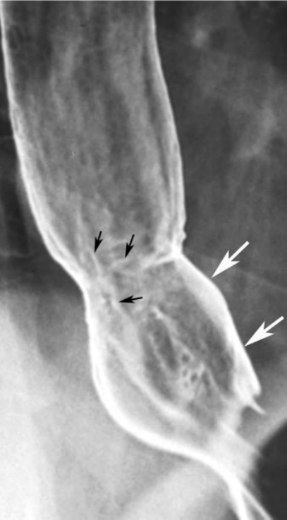
Barium Swallow Images
Reflux esophagitis with small linear ulcers (black arrows) in distal esophagus just above hiatal hernia (white arrows).
Notes:
Reflux esophagitis is inflammation of the esophagus caused by GERD

Slide 40
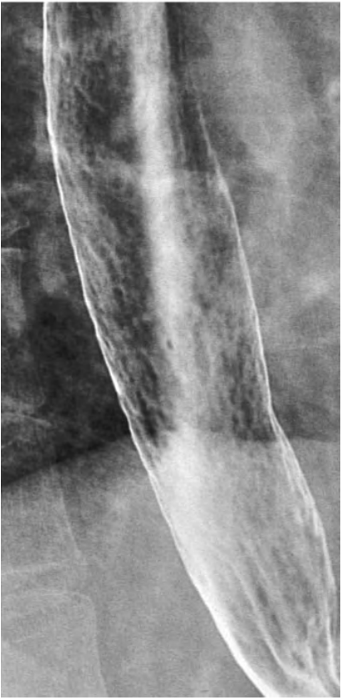
Barium Swallow Images
Reflux esophagitis with extensive granularity of lower esophagus due to edema and inflammation of mucosa

Slide 41
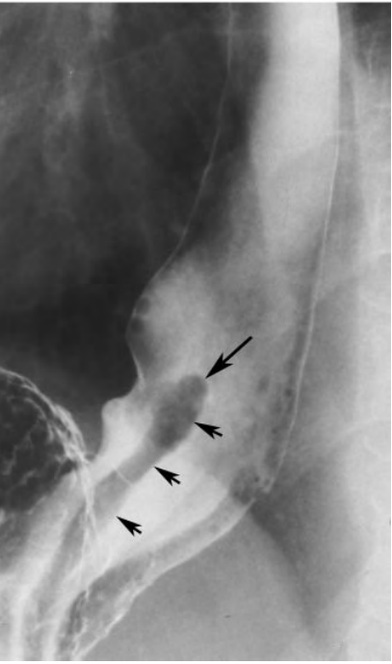
Barium Swallow Images
Inflammatory esophagogastric polyp as enlarged fold (small arrows) extending upward into distal esophagus, where it terminates as a smooth polypoid protuberance (large arrow).
Inflammatory polyps are thought to be a sign of chronic reflux esophagitis

Slide 42
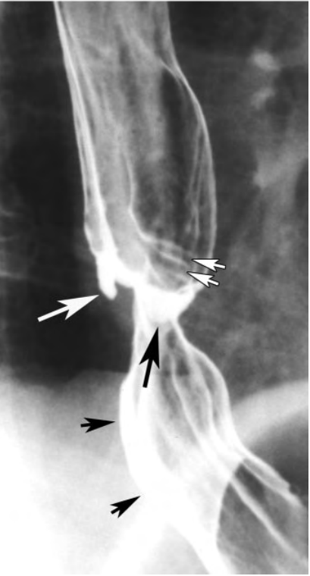
Barium Swallow Images
Asymmetric peptic stricture in distal esophagus above hiatal hernia (small black arrows), with sacculation of wall both en face (large black arrow)and in profile (large white arrow).
Note fixed transverse folds (small white arrows) from associated longitudinal scarring of distal esophagus above the stricture.
Notes:
Peptic strictures are the endstage result of chronic reflux esophagitis

Slide 43
Barium Swallow Images
Smooth tapered segment of concentric narrowing (white arrows) due to peptic stricture in distal esophagus above a hiatal hernia (black arrow)

Slide 44
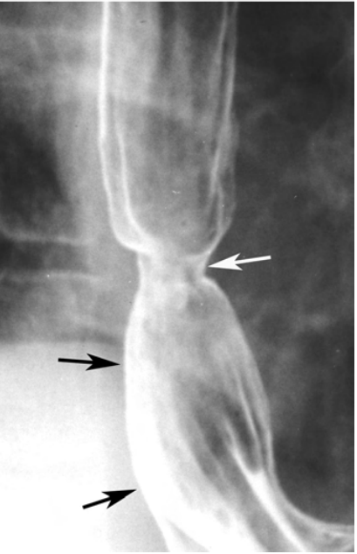
Barium Swallow Images
Short ring like peptic stricture (white arrow) in distal esophagus above a hiatal hernia (black arrows).
Although this stricture could be mistaken for a Schatzki ring, it has a longer vertical height than does a true Schatzki ring
Notes:
Schatzki ring is a narrowing of the lower esophagus that can cause difficulty swallowing (dysphagia).

Slide 45
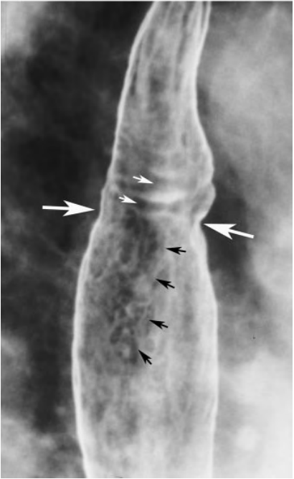
Barium Swallow Images
Mild ring like constriction (large white arrows) in mid esophagus in a patient with Barrett esophagus. Also note distinctive reticular pattern (black arrows) extending distally from the stricture, a classic radiographic sign of Barrett esophagus.
This patient also has fixed transverse folds (small white arrows) just above the stricture due to longitudinal scarring in this region.
Notes:
It is characterized by the replacement of the normal stratified squamous epithelium lining of the esophagus by simple columnar epithelium with goblet cells (which are usually found lower in the gastrointestinal tract).

Slide 46
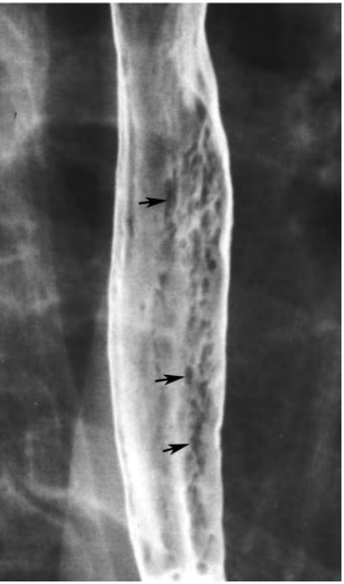
Barium Swallow Images
Multiple discrete plaque like lesions (arrows) in the esophagus in a patient with candida esophagitis.
Note how plaques have a linear configuration and are separated by normal intervening mucosa

Slide 47
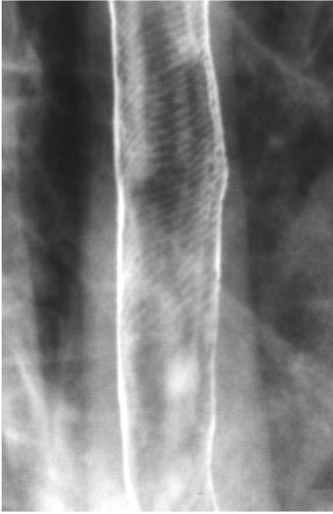
Barium Swallow Images
Thin transverse striations due to transient contraction of longitudinally oriented muscularis mucosae in patient with “feline” esophagus.
This finding is often associated with gastroesophageal reflux.
Notes:
Appearance of folds in the distal esophagus of the cat

Slide 48
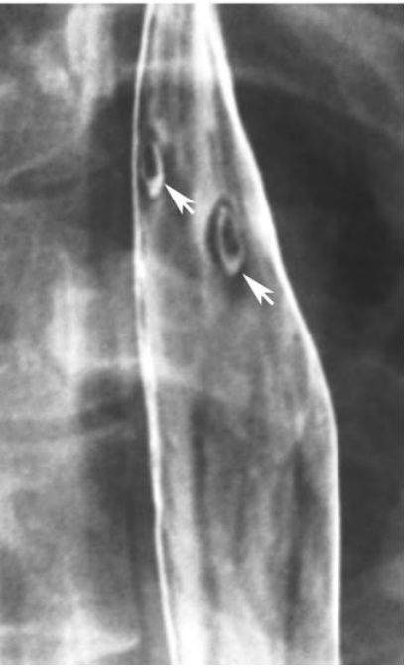
Barium Swallow Images
Two small superficial ulcers as ring shadows (arrows) in mid esophagus. This patient had drug- induced esophagitis after taking doxycycline.

Slide 49
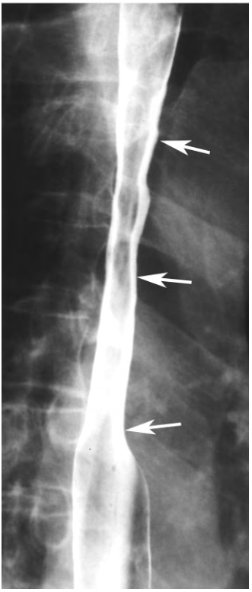
Barium Swallow Images
Radiation stricture as a long segment of smooth tapered narrowing (arrows) in upper thoracic esophagus.
This patient had undergone mediastinal irradiation.

Slide 50
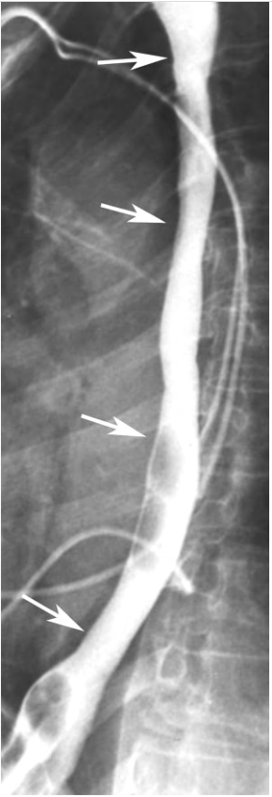
Barium Swallow Images
Long smooth stricture (arrows) in the thoracic esophagus caused by lye ingestion.
Also note cardiac pacemaker wires.

Slide 51
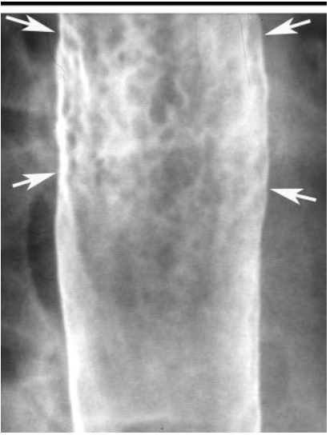
Barium Swallow Images
Superficial spreading carcinoma as focal area of mucosal nodularity (arrows) in mid esophagus, without a discrete mass.
Note how nodules merge with one another, producing a confluent area of disease.

Slide 52
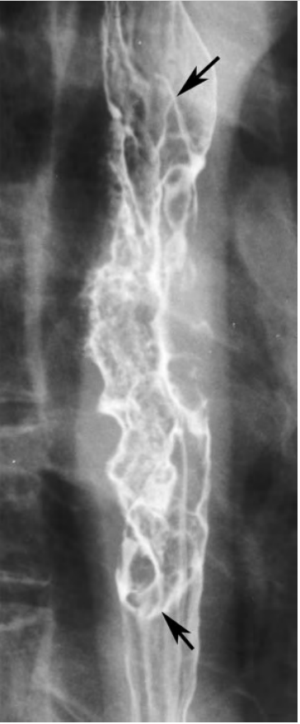
Barium Swallow Images
Advanced infiltrating carcinoma as irregular area of narrowing, with mucosal nodularity, ulceration, and shelf like margins (arrows) in mid esophagus

Slide 53
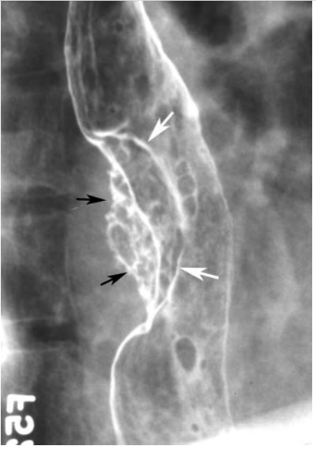
Barium Swallow Images
Advanced esophageal carcinoma as polypoid mass (white arrows) with a large area of ulceration (black arrows) on the right posterolateral wall of the distal esophagus (small rounded defects abutting mass are air bubbles)

Slide 54
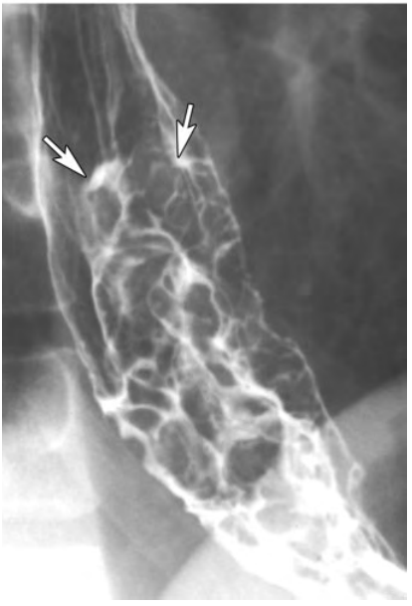
Barium Swallow Images
Varicoid carcinoma as lobulated submucosal lesion in the distal esophagus that could be mistaken for varices. However, this lesion had a fixed appearance at fluoroscopy and an abrupt proximal demarcation (arrows) from normal esophagus.
Notes:
The term varicoid is used to denote an esophageal carcinoma that has an uncommon pattern of dissemination via the vasculature and the lymphatic system to the submucosa.

Slide 55
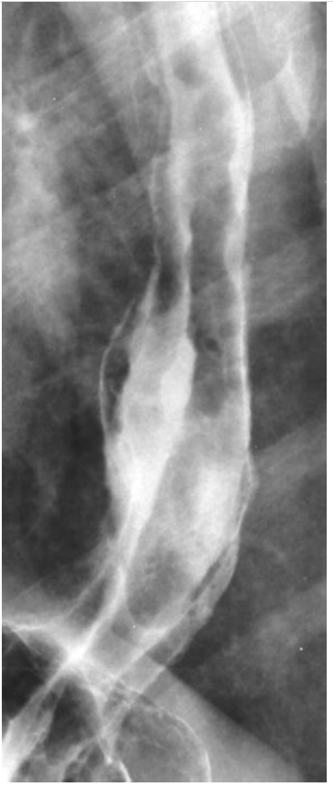
Barium Swallow Images
Uphill esophageal varices as serpiginous defects in lower esophagus.
This patient had portal hypertension.

Slide 56
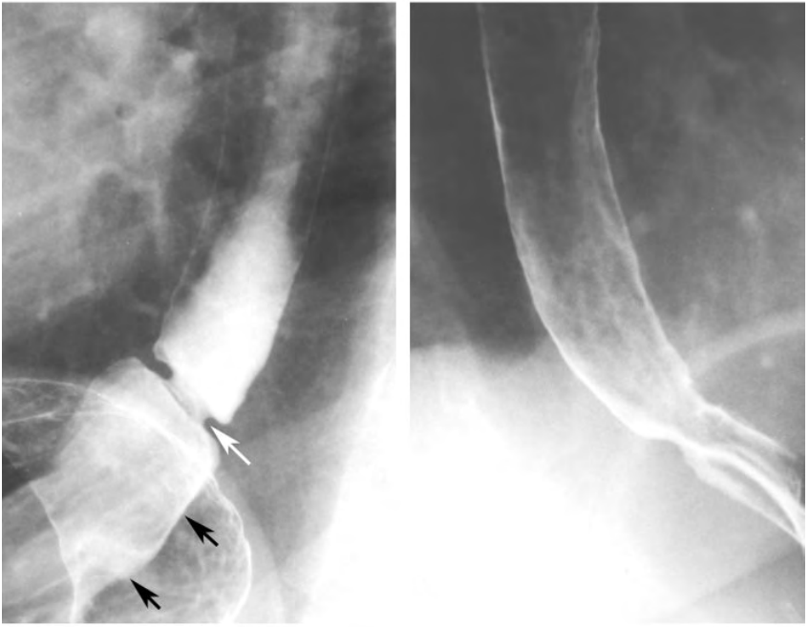
Barium Swallow Images
Schatzki ring as smooth, symmetric, ring like constriction (white arrow) in distal esophagus directly above a hiatal hernia (black arrows).
Same examination shows mild narrowing of distal esophagus without demonstration of the ring because of inadequate distention of this region.

Slide 57
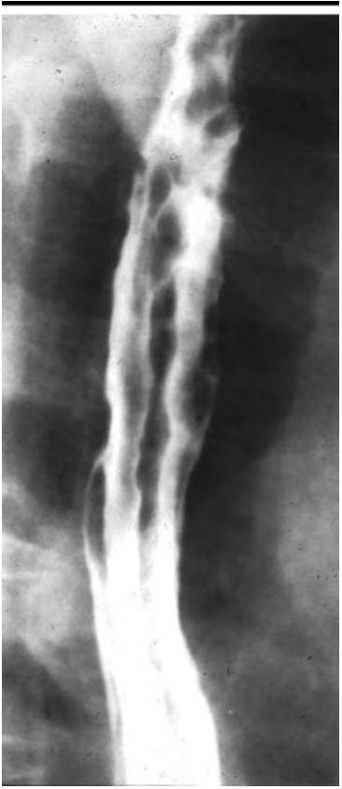
Barium Swallow Images
Downhill esophageal varices as serpiginous defects in mid esophagus above the level of the carina.

Slide 58
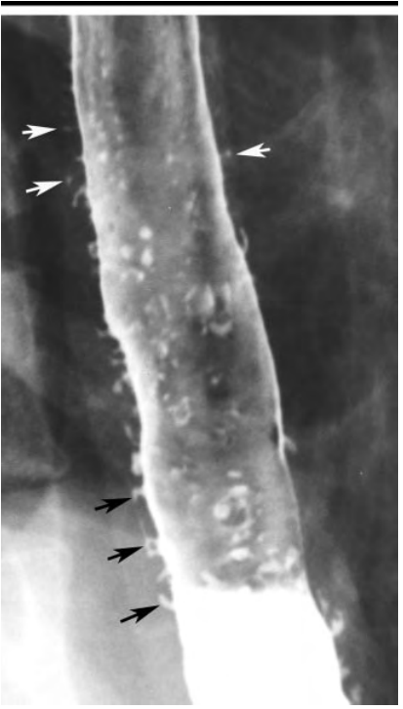
Barium Swallow Images
Multiple esophageal intramural pseudo diverticula as flask-shaped outpouchings (black arrows) in longitudinal rows parallel to the long axis of the esophagus.
Note how some pseudodiverticula (white arrows) appear to be floating outside the esophagus without apparent communication with the lumen.

Slide 59
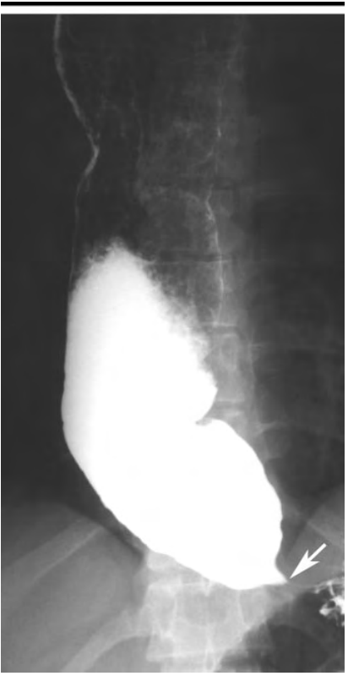
Barium Swallow Images
Shows typical findings of primary achalasia, with dilated aperistaltic esophagus and tapered beaklike narrowing (arrow) of distal esophagus due to incomplete opening of the lower esophageal sphincter.
This image was obtained in a middle-aged patient with long-standing dysphagia.
Notes:
Achalasia is a primary motor disorder of the esophagus characterized by insufficient lower esophageal sphincter relaxation and loss of esophageal peristalsis
Primary achalasia is the most common subtype and is associated with loss of ganglion cells in the esophageal myenteric plexus.

Slide 60
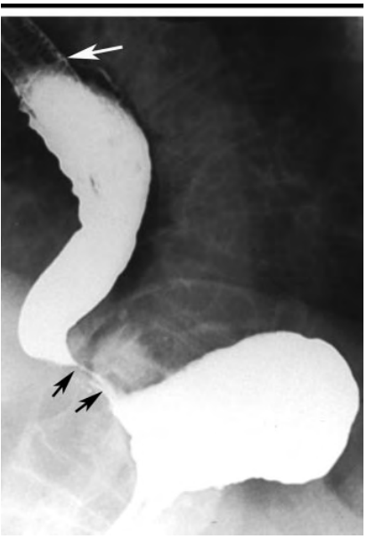
Barium Swallow Images
Beaklike narrowing (black arrows) of distal esophagus caused by secondary achalasia. Note greater length of narrowed segment than is usually seen in primary achalasia
Also note metallic esophageal stent (white arrow) for palliation of esophageal carcinoma, which presumably had spread to gastroesophageal junction
This image was obtained in an elderly patient with recent onset of dysphagia and weight loss.
Notes:
Secondary achalasia is relatively uncommon. This condition exists when a process other than intrinsic disease of the esophageal myenteric plexus is the etiology. Examples of maladies causing secondary achalasia include certain malignancies, diabetes mellitus, and chagas disease. (tropical disease caused by parasite Trypanosoma cruzi

Slide 61
Summary
A Normal EFT profile include
Esophageal manometry showing a normal peristaltic wave progression and amplitude along with a complete LOS relaxation with a swallow
24 Hour Esophageal pH showing a pH >4 of greater than 98.5% of the 24 hour monitored period
A negative Bernstein test and an acid clearing test of less than 10 swallows
A barium swallow fluoroscopy & x-ray showing normal size, shape, position, patency and filling of the esophagus and an absent reflux

Slide 62
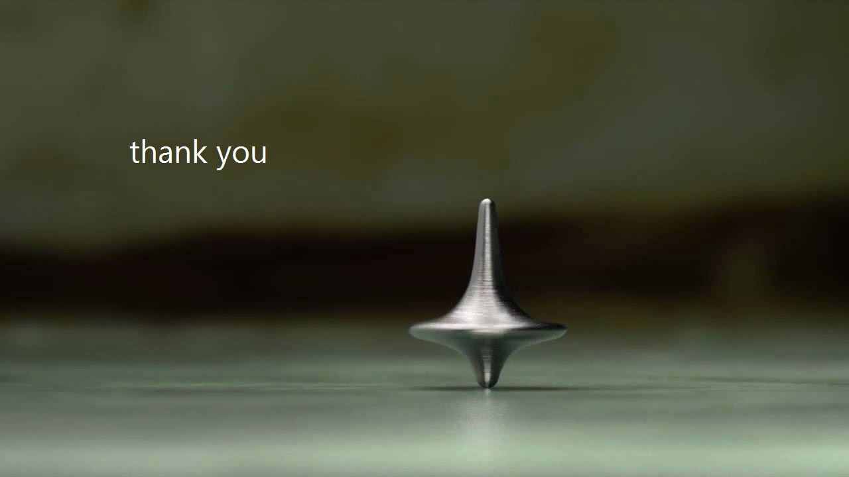
sengukoi

