Slide 1
Efficacy and long term safety of a dengue vaccine in regions of endemic disease
Dr. Ravi (PGY1 - General Medicine)

Slide 2


Published in the Journal – NEJM, Volume 373, No – 13.
On September 24th 2015
S.R. Hadinegoro, J.L. Arredondo-García, M.R. Capeding, C. Deseda, T. Chotpitayasunondh, R. Dietze, H.I. Hj Muhammad Ismail, H. Reynales, K. Limkittikul, D.M. Rivera-Medina, H.N. Tran, A. Bouckenooghe, D. Chansinghakul, M. Cortés, K. Fanouillere, R. Forrat, C. Frago, S. Gailhardou, N. Jackson, F. Noriega, E. Plennevaux, T.A. Wartel, B. Zambrano, and M. Saville, for the CYD-TDV Dengue Vaccine Working Group

Slide 3
Meta Analysis Involving The Following Trials
Study | Countries (Region) | Study Population | Stage of the clinical trial
CYD14 | Asia Pacific | 10,278 | Stage 3 trial
CYD15 | Latin America | 20,875 | Stage 3 trial
In addition, another stage 2b trial (CYD23) completed in Thailand was also invited for a follow up study for 4 years to assess the safety of the dengue vaccine
Notes:
Stage 1 – Healthy volunteers, dose ranging, sub-therapeutic, ascending doses, 100.
Stage 2 – Done to assess efficacy and safety of the drug/vaccine, in therapeutic doses, 300.
Stage 3 – Efficacy, safety & effectiveness, in therapeutic doses, 2000.
Stage 4 – Post market surveillance – Getting Rx from physician

Slide 4

Funded by
Sanofi Pasteur
Notes:
Vaccination arm of Sanofi -> Largest multinational company dedicated to vaccination -> HQ in France

Slide 5
Introduction
A recombinant live attenuated tetravalent dengue vaccine (CYD-TDV) has been assessed in two phase 3 randomized controlled efficacy trials involving a study population of > 31,000.
The vaccine was administered in three doses. At baseline, at 6 months and after 12 months
Vaccine efficacy against virologically confirmed dengue and safety was assessed during a 25 month efficacy surveillance phase
Notes:
Recombinant – Genetically engineered DNA
Live Attenuated – Viable virus but with reduced virulence
Randomization – Computer generated sequence
Controls – Placebo

Slide 6
Introduction
Vaccination significantly reduced the incidence of virologically confirmed dengue and showed acceptable safety and reactogenicity profiles, findings that were consistent with earlier results.
In the ongoing longer-term follow-up (from year 3 to year 6) to assess safety, we are monitoring to evaluate for any potential predisposition in vaccinated persons to increased severity of disease.
Notes:
Reactogenicity – Property of the vaccine to produce adverse effects

Slide 7
In essence, this journal article is about the
Meta Analysis of the three trials to study the
Efficacy of the dengue vaccine
Long term safety profile of the vaccine

Slide 8
Methods
All three trials were observer-masked, randomized controlled trials.
CYD14 & CYD15 were multicentric, phase three trials.
CYD14 was performed in the Asian Pacific countries – Indonesia, Malaysia, Philippines, Thailand & Vietnam.
CYD15 was performed in the Latin American countries - Columbia, Mexico, Brazil, Puerto Rico & Honduras
Notes:
Observer-masked – Double blind study. Participants and observers are blinded. Remove the observer bias

Slide 9
Methods
Trial Procedures
The participants were originally randomly assigned in a 2:1 ratio to the vaccine group or the control group, stratified according to age.
Participants attended yearly clinic visits, with regular contact (≥1 contact every 3 months) between visits. Hospitalization for acute fever was recorded during study contacts and visits, as well as by self-report and surveillance at non-study hospitals.
Blood samples during the acute phase of illness were obtained for virologic confirmation of dengue infection

Slide 10
Methods
Trial Oversight
The sponsor designed the trials and performed sample testing and data analyses. The investigators collected the data, and the sponsor and the investigators interpreted the data and collaborated in the preparation of the manuscript.
Study Outcomes
All analyses that are presented here were pre-specified. Ages refer to the ages at initial enrollment.

Slide 11
Methods
Long Term Follow Up Analysis
The objective of the follow-up analyses was to describe the long-term safety of the dengue candidate vaccine, as recommended by the WHO
To verify that the immune response to vaccination does not confer a predisposition to severe disease
The risk of severe disease does not increase with time owing to waning titers of vaccine-induced antibodies in persons in whom immunity has not been naturally boosted

Slide 12
Methods
Pooled Efficacy Analyses
The objective of the pooled CYD14 and CYD15 analyses was to assess the efficacy of CYD-TDV against virologically confirmed dengue, hospitalization for dengue, and severe illness
Data Sets Included In The Analysis
Safety analysis set included participants who had received at least one dose of vaccine
Pooled efficacy analysis set included participants who had received three doses of vaccine and who had no pre-specified protocol deviations.

Slide 13
Methods
Statistical Analysis
Calculation of the annual incidence rates (expressed as a percentage)
Number of participants who had atleast one event/Number of participants present at the start of the study period
A Cox Regression Model was used to estimate the pooled vaccine efficacy
Notes:
Cox Regression Model – Method for investigating the effect of several variables upon the time a specified event takes to happen.

Slide 14
Methods
An analysis of interaction was added in the model to test for heterogeneity, with a p value of less than 0.10 considered to indicate statistical significance. Suspected interactions were assessed for their clinical and statistical relevance.
Notes:
P values are used to test null hypothesis. P <0.1 -> null hypothesis does not hold. P >0.1 ->no evidence that the null hypothesis does not hold

Slide 15
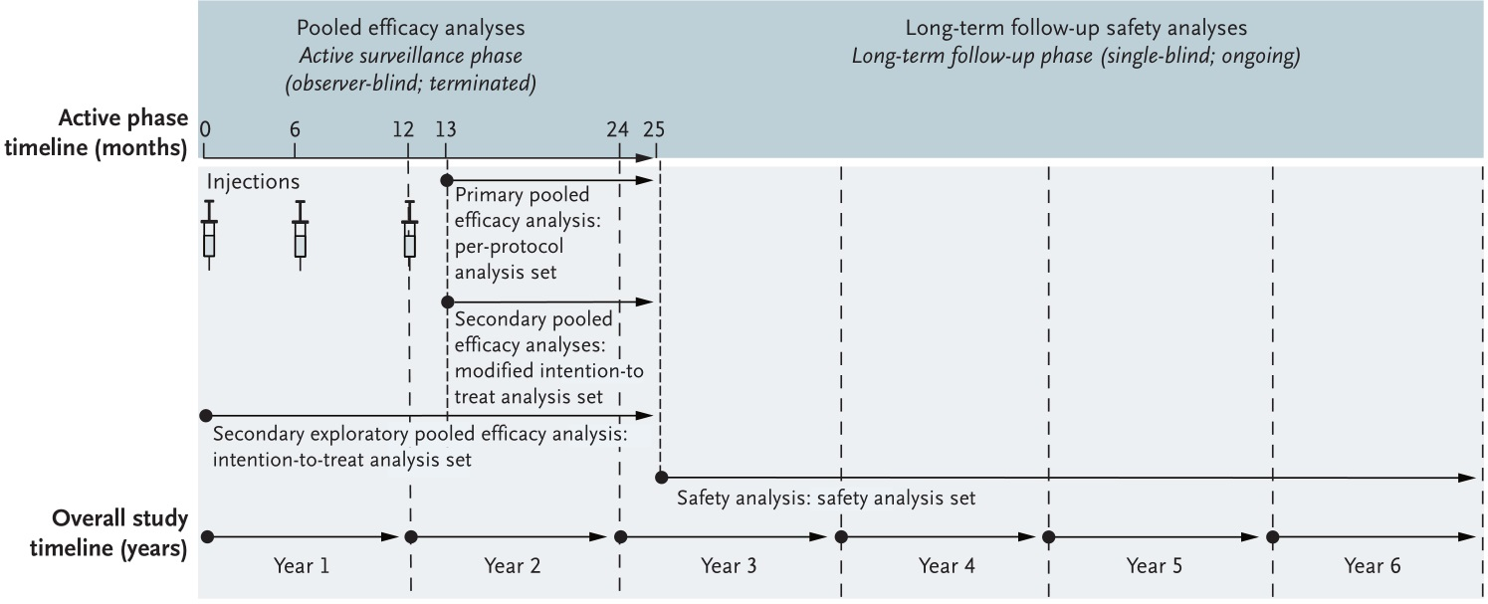
Methods
Notes:
Per protocol – Only includes individuals who adhered to the clinical trial instructions as specified in the study protocol. Appropriate when analyzing adverse events
Intention to treat – All patients who are randomly allocated to the Rx are included in the analysis even if non-compliant, protocol violations. To study drug effectiveness, preserve the baseline, preserve the sample size. Helps to compare with per protocol

Slide 16
Results
Pooled Analysis For Vaccine Efficacy
Efficacies were higher among participants who were 9 years of age or older (pooled estimate of 65.6%) and lower among participants who were under 9 years of age (pooled estimate of 44.6%).
The pooled serotype-specific vaccine efficacies ranged from 47.1% (95% CI, 31.3 to 59.2) for serotype 2 to 83.2% (95% CI, 76.2 to 88.2) for serotype 4 among participants who were 9 years of age or older (Fig. 2A).
Among those under the age of 9 years, the range was from 33.6% (95% CI, 1.3 to 55.0) for serotype 2 to 62.1% (95% CI, 28.4 to 80.3) for serotype 3
Notes:
Efficacy - % reduction in disease incidence in a vaccinated group compared to an unvaccinated group under optimal conditions
Vaccine effectiveness - ability of vaccine to prevent outcomes of interest in the “real world”

Slide 17
Results
Pooled vaccine efficacy among seropositive participants was 81.9% (95% CI, 67.2 to 90.0) among those who were 9 years of age or older. It was 70.1% (95% CI, 32.3 to 87.3) among those who were younger than 9 years of age
Pooled vaccine efficacies against hospitalization for dengue among participants who were 9 years of age or older were 80.8% (95% CI, 70.1 to 87.7) as compared with 56.1% (95% CI, 26.2 to 74.1) among participants under the age of 9 years
The vaccine efficacies against dengue hemorrhagic fever were 92.9% (95% CI, 76.1 to 97.9) and 66.7% (95% CI, −4.7 to 90.2) in the two groups respectively

Slide 18
Results
Interim Long Term Safety Analysis
The pooled relative risk of hospitalization for virologically confirmed dengue in the vaccine group as compared with the control group was 0.84 (95% CI, 0.56 to 1.24).
The majority of patients had serotype 1 or 2 infection; serotype 4 was the least frequently identified serotype
No clinically important differences in the frequencies of signs and symptoms were observed between the vaccine and control groups, suggesting that there were no vaccine-related changes in the clinical picture of hospitalized participants.
Notes:
Relative risk 1 -> No difference in risk
RR < 1 -> Risk less likely in experimental group
RR > 1 -> Risk more likely in experimental group

Slide 19
Results
Interim Long Term Safety Analysis
All the participants who were hospitalized for virologically confirmed dengue during follow-up had a full recovery after receiving appropriate supportive treatment.
Long Term Follow Up According To Age Group
The pooled relative risks among participants younger than 9 years of age was 1.58 (95% CI, 0.83 to 3.02), which suggests an overall trend to increased risk in the vaccine group.
The pooled relative risk among participants who were 9 years of age or older was 0.50 (95% CI, 0.29 to 0.86).
Notes:
95% CI -> With 95% confidence says that the true mean of the data lies between the two values.
Mean -> Average of numbers
Median -> Number at halfway in the set
Mode -> Value that appears most often

Slide 20
Results
Long Term Follow Up According To Age Group
The overall pooled estimate of the relative risk of hospitalization for severe dengue was 1.50 (95% CI, 0.60 to 3.79) for all the participants, as compared with 0.50 (95% CI, 0.16 to 1.55) for participants who were 9 years of age or older.

Slide 21
Summary - Analysis
Pros
In summary, some of the pros of the vaccine are
It offers very good efficacy for older individuals against the severe forms of the disease (92.9% against DHF) and also against hospitalization (80.8%)
The efficacy for older individuals who are seropositive is also high (81.9%)
The efficacy of the vaccine against serotype 4 is high (83.2%)
The pooled relative risk for older individuals is 0.5 indicating good safety profile

Slide 22
Summary - Analysis
Cons
In summary, some of the cons of the vaccine are
It requires three doses in one year, hence affecting compliance
Poor efficacy against serotype 2 (47.1%)
Poor efficacy in dengue naïve individuals (seronegative individuals)
Lower efficacy in younger individuals (< 9 years of age)
Enhanced number of hospitalization in children younger than five years after 1-2 years of vaccination
Due to which the WHO supports the idea of co-development of next-generation dengue vaccine candidates.

Slide 23
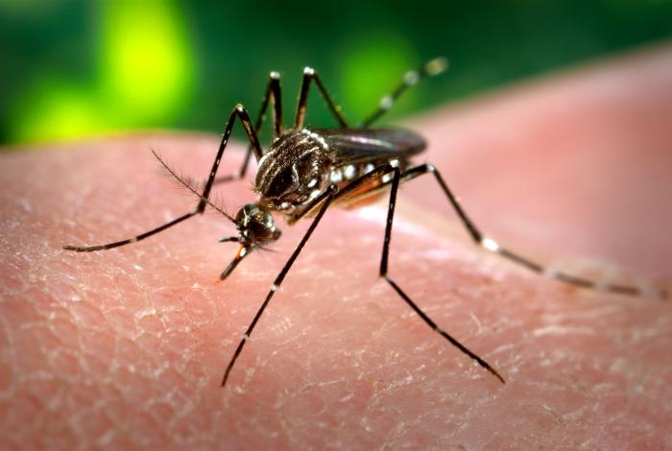
Dengue Fever
Dengue fever is a tropical mosquito borne disease caused by the dengue virus
The mosquito responsible is the Aedes aegypti
Notes:
Dengue – Swahili – Evil Spirit
White marking near the legs and body.
More commonly bites in the dusk, dawn, indoor, shady places
Also carrier for chikungunya and yellow fever

Slide 24
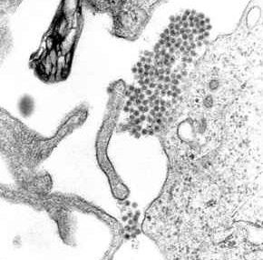
Virology
The dengue virus is an RNA virus belonging to the family Flaviviridae and to the genus Flavivirus.
There are five strains of the virus, called serotypes, of which the first four are referred to as DENV-1, DENV-2, DENV-3 and DENV-4. The fifth was announced in 2013
Notes:
Flavivirus – West Nile, Japanese Encephalitis, Yellow Fever

Slide 25
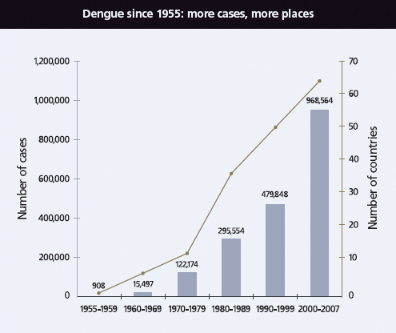
Disease Burden - Worldwide Cases Of DHF

Slide 26
Clinical Features
Upto 80% of the people infected by Dengue virus are asymptomatic or have only mild symptoms such as fever.
Others (5%) have more severe illness and in a few it is life threatening
The disease tends to be more severe in children and females, people with high BMI, and those with a higher viral load
The incubation period is between 4 to 7 days

Slide 27
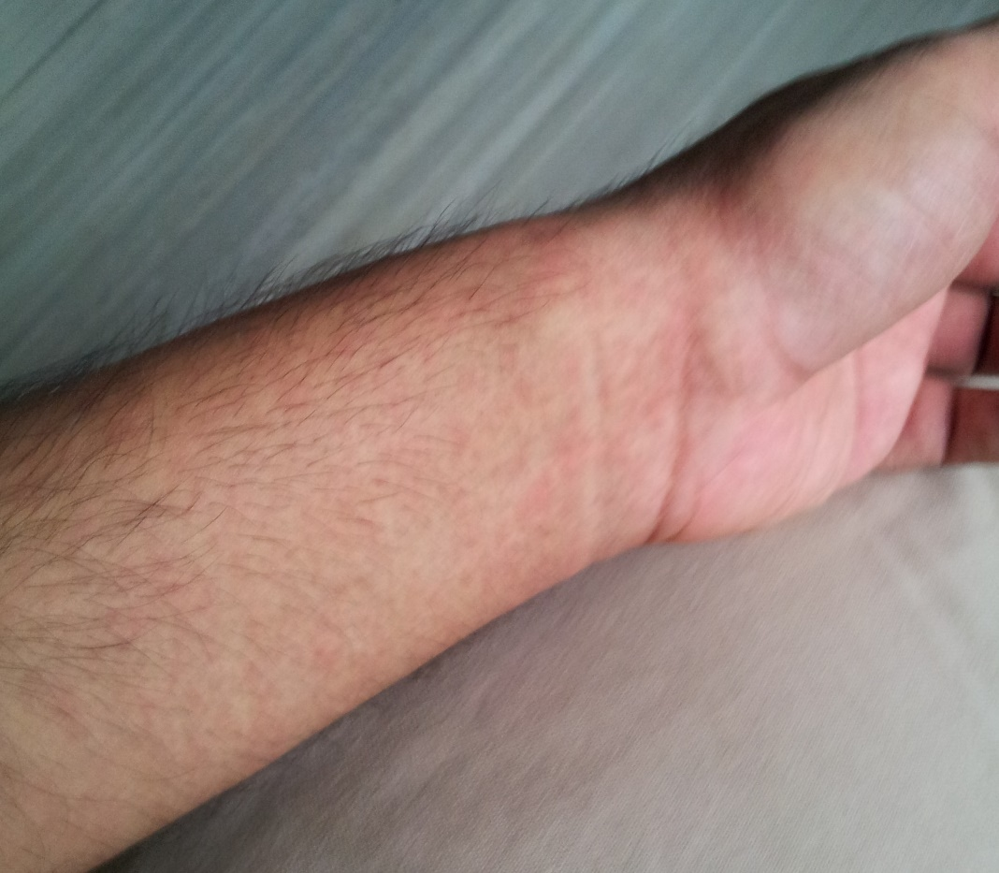
Clinical Features
Clinical course divided into three phases
Febrile Phase (1st Phase)
The febrile phase involves high fever, potentially over 40 °C (104 °F), and is associated with generalized pain and a headache; this usually lasts two to seven days.
A rash occurs in 50–80% of those with symptoms in the first or second day of symptoms as flushed skin, or later in the course of illness (days 4–7)

Slide 28
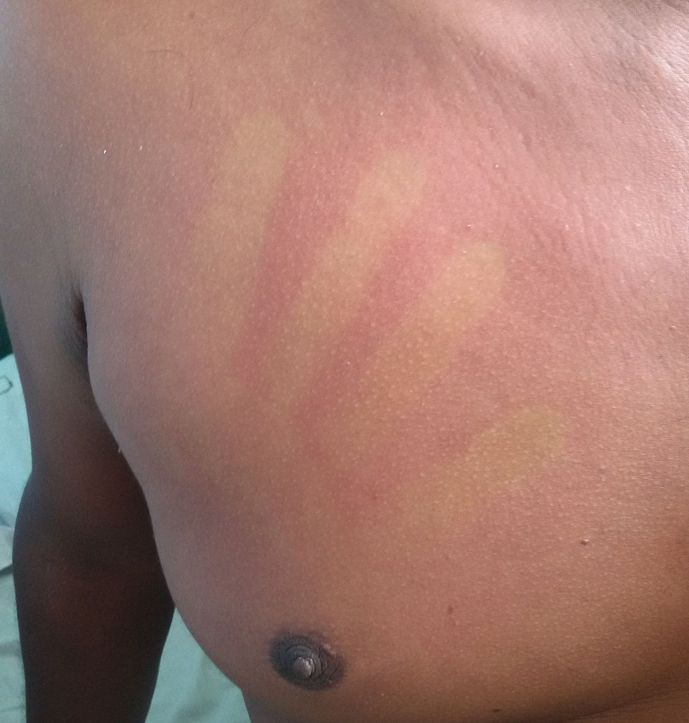
Rash in febrile phase blanches to pressure

Slide 29
Clinical Features
Critical Phase (2nd Phase)
In some people, the disease proceeds to a critical phase as fever resolves. During this period, there is leakage of plasma from the blood vessels, typically lasting one to two days.
This may result in fluid accumulation in the chest and abdominal cavity as well as depletion of fluid from the circulation and decreased blood supply to vital organs. There may also be organ dysfunction and severe bleeding, typically from the gastrointestinal tract.

Slide 30
Clinical Features
Critical Phase (2nd Phase)
Shock (dengue shock syndrome) and hemorrhage (dengue hemorrhagic fever) occur in less than 5% of all cases of dengue, however those who have previously been infected with other serotypes of dengue virus ("secondary infection") are at an increased risk.
This critical phase, while rare, occurs relatively more commonly in children and young adults.

Slide 31
Clinical Features
Recovery Phase (3rd Phase)
There is resorption of the leaked fluid into the bloodstream. This usually lasts two to three days.
The improvement is often striking, and can be accompanied with severe itching. Another rash may occur with either a maculopapular or a vasculitic appearance, which may be followed by peeling of the skin.
During this stage, a fluid overload state may occur; if it affects the brain, it may cause a reduced level of consciousness or seizures.

Slide 32
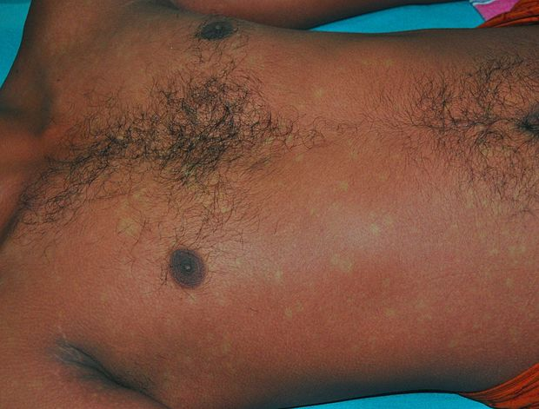
The rash that commonly forms during the recovery from dengue fever with its classic islands of white in a sea of red

Slide 33
Diagnosis
The earliest change detectable on laboratory investigations is a low WBC, which may then be followed by low platelets and metabolic acidosis.
In severe disease, plasma leakage results in hemo-concentration (as indicated by a rising hematocrit) and hypoalbuminemia.
Pleural effusions or ascites may also occur.
Dengue shock syndrome is present if pulse pressure drops to ≤ 20 mm Hg along with peripheral vascular collapse.
Positive tourniquet test (Capillary fragility test)
Virus isolation in cell cultures, nucleic acid detection by PCR, viral antigen detection (such as for NS1) or specific antibodies (serology).
Notes:
Peripheral Vascular Collapse – Assessed by tachycardia, cold extremities and increased capillary refill time
Tourniquet test – Inflate the BP cuff to in-between SBP and DBP.
Keep for 5 minutes and then measure the number of petechiae in 1 square inch.
If more than 10, then suggestive of dengue

Slide 34
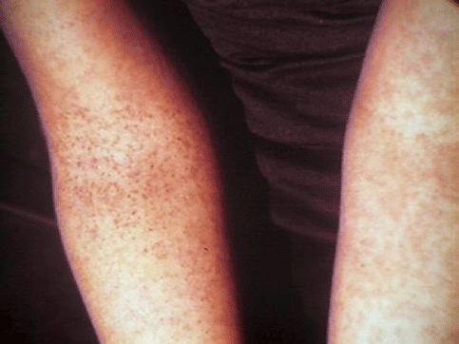
Positive tourniquet test

Slide 35
Treatment
Intravenous hydration, if required, is typically only needed for one or two days. The rate of fluid administration is titrated to a urinary output of 0.5–1 mL/kg/h, stable vital signs and normalization of hematocrit.
Blood transfusion is initiated early in people presenting with unstable vital signs and a decreasing hematocrit
Paracetamol is used for fever. Aspirin & Ibuprofen are avoided.
During the recovery phase intravenous fluids are discontinued to prevent a state of fluid overload

Slide 36
Vaccination – Indian Update
2014 study of the vaccine on Indian adults (18-45) in Delhi, Ludhiana, Bangalore, Pune and Kolkata found the Sanofi funded CYD TDV vaccine safe, with results comparable to other clinical studies in Asia.
According to Sanofi, the vaccine will most likely be available in India as a first generation dengue vaccine, subject to regulatory approval, later this year or early next year.

Slide 37
Other potential dengue vaccine candidates
Name of the vaccine | Company Sponsoring | Phase of the trial
DENVax - recombinant chimeric vaccine with DENV1, DENV3, and DENV4 components on a dengue virus type 2 (DENV2) backbone | Takeda Pharmaceuticals | Undergoing Phase 2
TetraVax-DV - tetravalent admixture of monovalent vaccines that were tested separately for safety and immunogenicity. | National Institute of Allergy & Infectious disease | Currently in Phase 2
TDENV PIV - inactivated tetravalent vaccine | GlaxoSmithKline | Undergoing Phase 1
V180 - recombinant subunit vaccines | Merck | Undergoing Phase 1

Slide 38
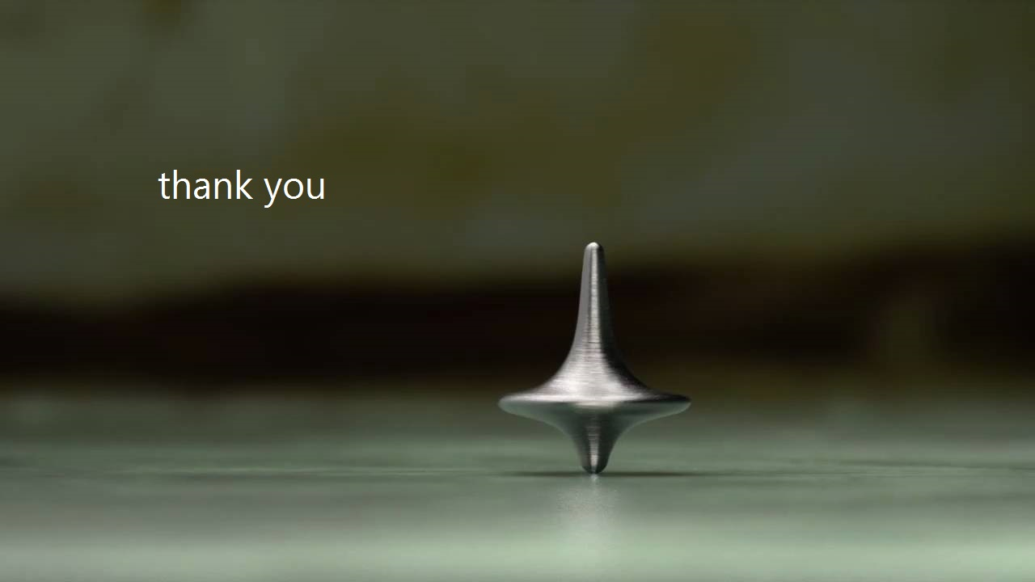
sengukoi

